Slide 1
Assessing the Limits of Synthetic Controls
A Time Series Approach to Observational Studies

Slide 2
Key Idea
Want to estimate treatment effects in observational studies
Typically, settings where only few observations for treatment and control group at hand (Countries, Counties, ...)
Parallel trends assumption also unlikely to hold
Idea: Instead of having many individually poor control groups, synthetize one control group that is best with respect to some criteria
Abadie and Garadeazabal (2003): Compute convex combination of donors that fits quantity of interest and potential covariates in the pre-treatment period best
Use this convex combination to estimate counterfactual in the post-treatment period
Convex combination: Restrict weights to lie in [0,1] and to sum up to 1 to avoid extrapolation/ overfitting

Slide 3
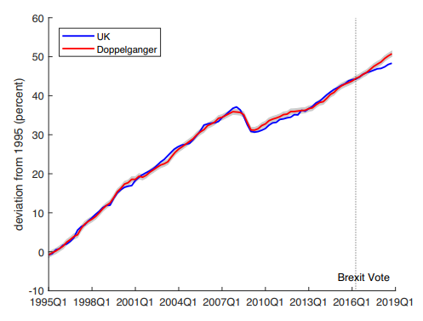
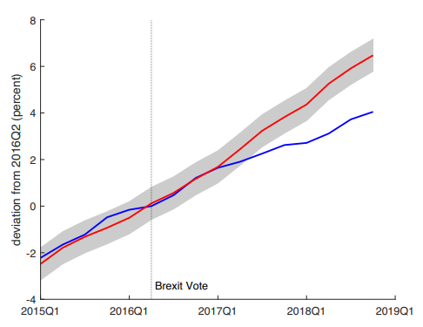
Example: The Costs of Economic Nationalism

Slide 4
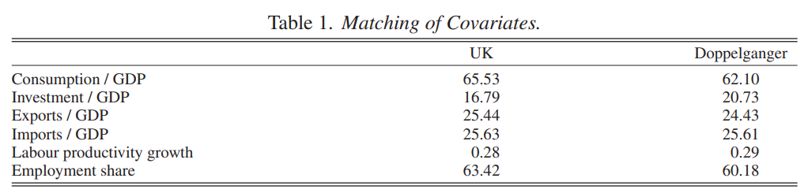
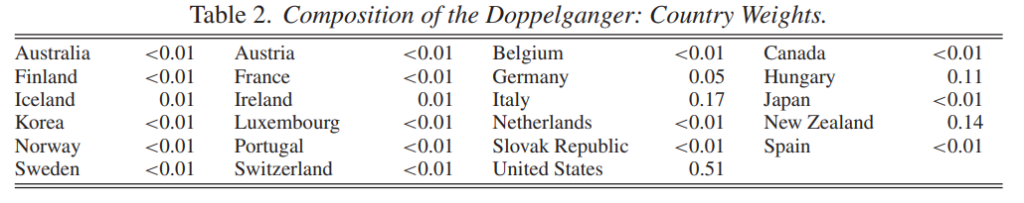
Straightforward to interpret results

Slide 5
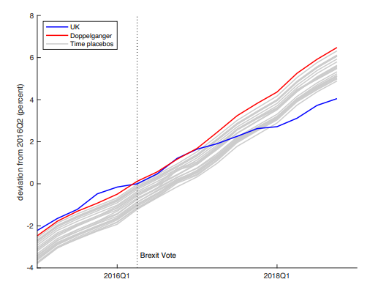
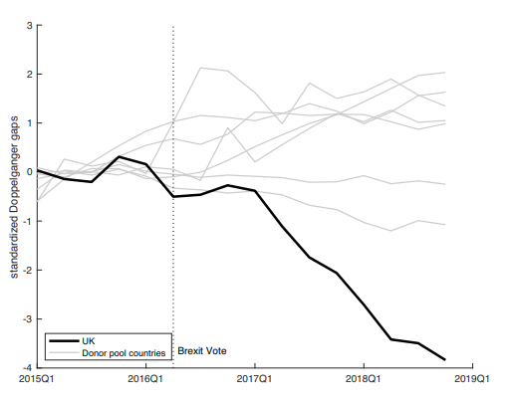
Placebo tests

Slide 6
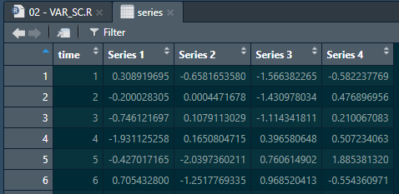
Shortcomings
Selection bias: Method mostly applied to settings where quantity is easy to forecast
Does simplicity of the method justify potentially poor forecasts also in more complex data sets?
Easy to achieve to good fit in pre-treatment period (training), must ensure that model generalizes well in post-treatment period (test)
Method requires time series/ panel structure, does not fully utilize the available data structure though
→ Use combined time series and SC-approach: VAR-SC

Slide 7

Overview of Methods
Model/ Information | Pre-Period | Current Period | Own Series | Donor Series | Parameter Restrictions
OLS
SC
VAR
VAR-SC

Slide 8
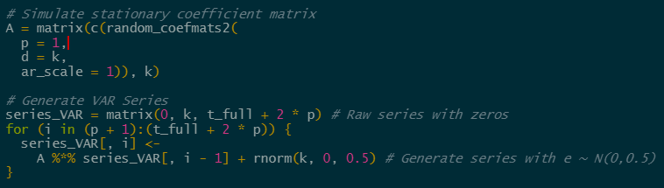
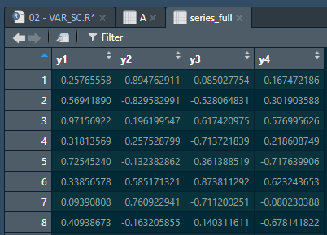
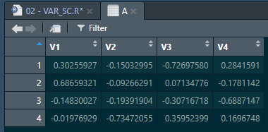
Simulation of stationary VAR(1)-Process

Slide 9
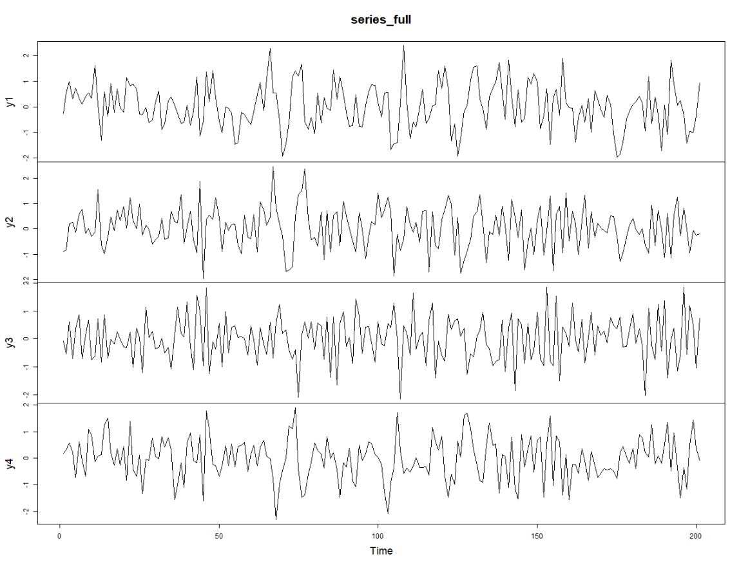
Simulation of stationary VAR(1)-Process

Slide 10
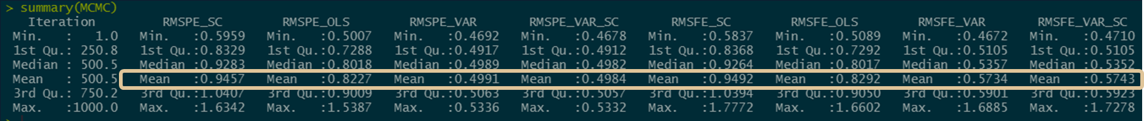
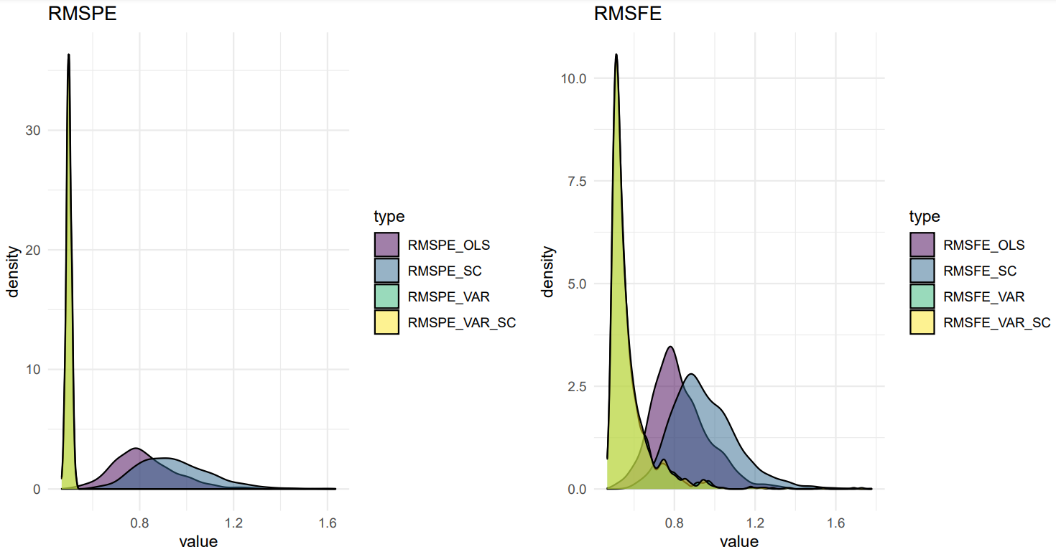
Estimation of stationary VAR(1)-Process
K = 5
Obivous finding: VAR(1)-model seems to be superior when it comes to predicting a VAR(1)-Process

Slide 11
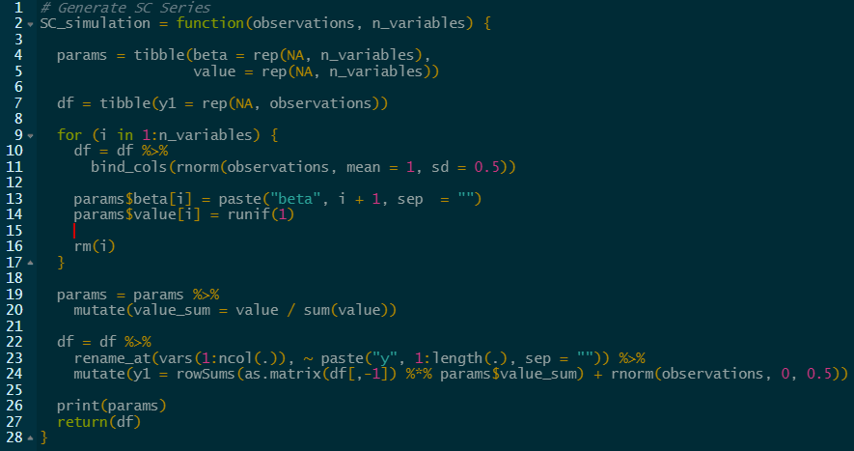
Simulation of SC-Process

Slide 12
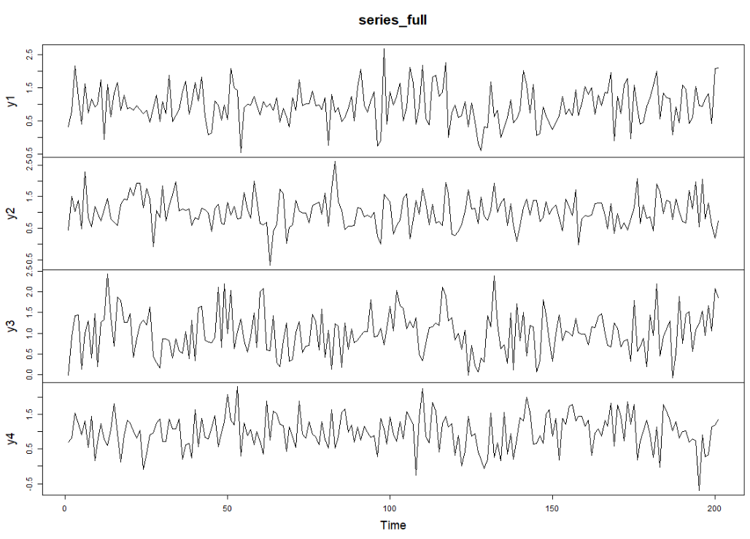
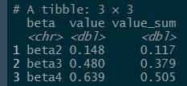
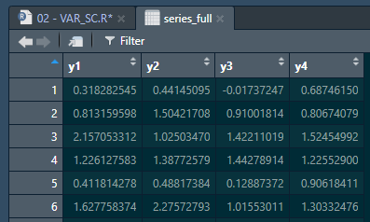
Simulation of SC-Process

Slide 13
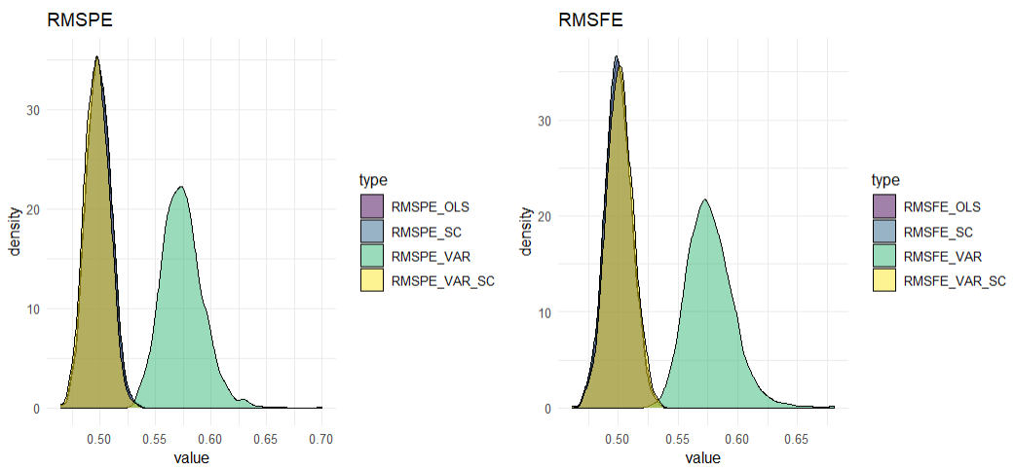
Estimation of SC-Process
K = 5
Obivous finding: SC-model seems to be superior when it comes to predicting a SC-Process

Slide 14
Grid Search
Pure VAR-process
Pure SC-process
VAR-model
VAR-SC-model
SC-model
VAR-model
Grid Search:
VAR-model best when data is generated by VAR-process
SC-model best when data is generated by SC-process
Can we identify sweet spot for VAR-SC-model?
Goal: Develop statistic that gives educated advice on which method to go for
Hurdles/ Extensions:
Extend methodology to case that allows for covariates: VAR-X/ ADL-model
See result for existing applications
Come up with nice own application

Slide 15
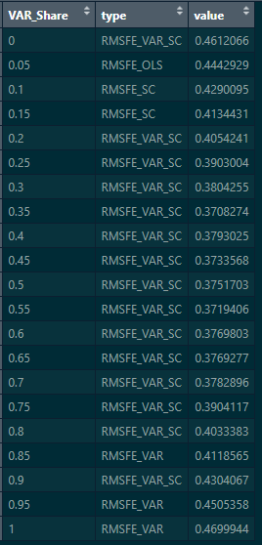
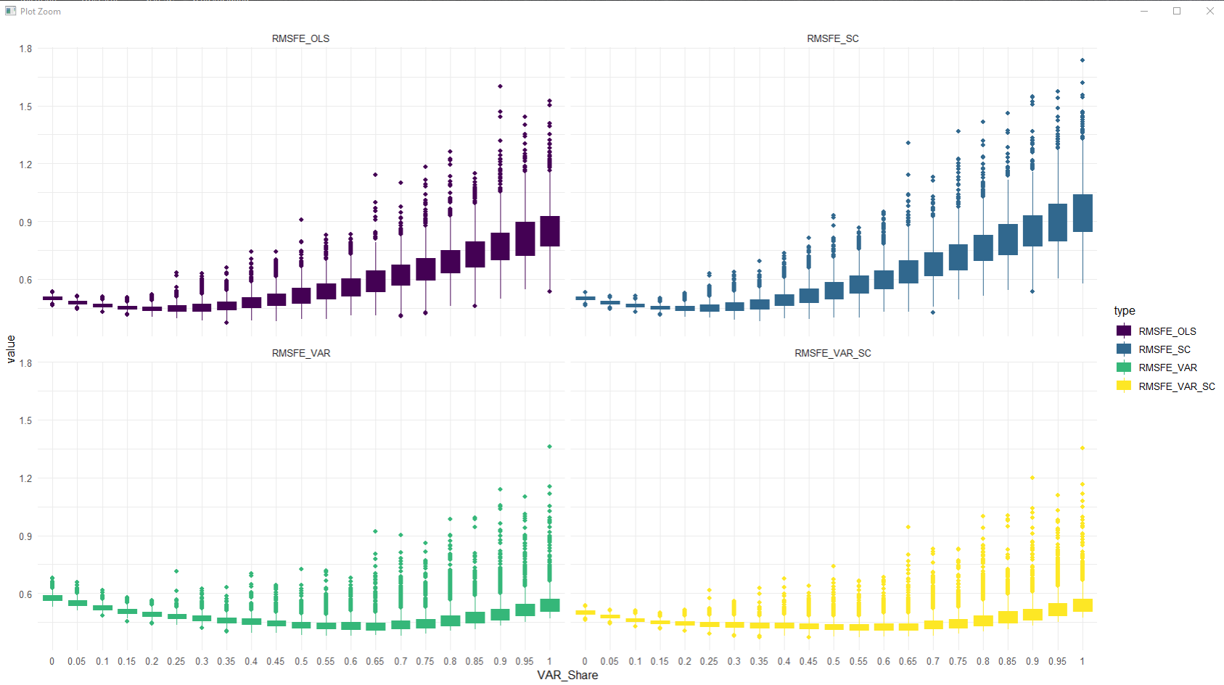
VAR_SC looks good with few donors
K = 5; Iterations = 1,000; Length = 1,000
1
2
3
15

Slide 16
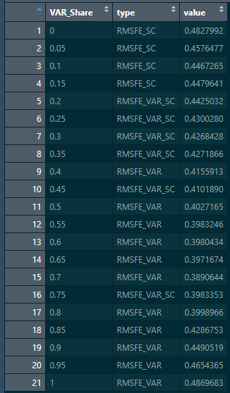
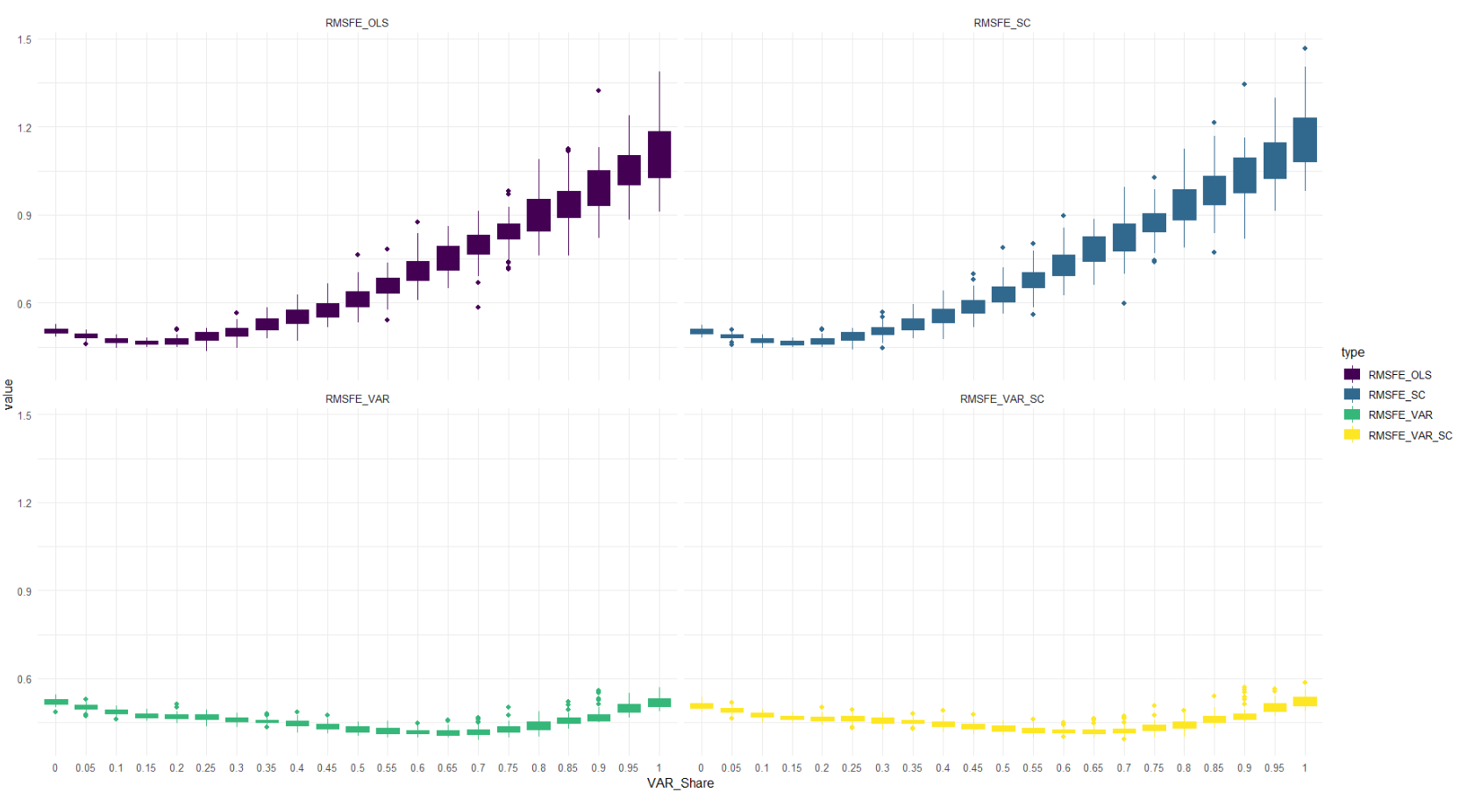
Need regularization with plenty of donors
K = 50; Iterations = 50; Length = 1,000
0
4
11
6

Slide 17
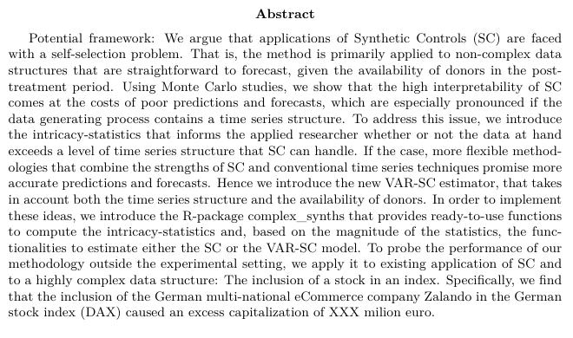
Potential framework

Slide 18
Aspects to consider
Regularization - Could penalize distance to SC-estimate (calibration), Time-Series cross validation to obtain optimal parameter value - Could also directly penalize for deviations from specific model (VAR, Factor, …)
Data structure: - Case with covariates needed? Harvey and Thiele (2019) omit covariates. - Relationship between N and T - Small sample properties in context of SC important → Harvey and Thiele (2019) - Highlight contextual requirements
Inference: - Chernozhukov, Hahn and Chi (2017) - Structural breaks, Andrews’ end of sample test (2003) - parameter significance - permutation - placebo - should be able to show unbiasedness/consistency of own estimator → proof
Simulate SC the right way - Factor model: Ferman (2021), also addressed in Abadie er al. (2010) - AR: Abadie et al. (2010), Ben-Michael (2021a)
Develop/ find statistic that approximates VAR_share

Slide 19
Potential Structure
Introduction
Methodological Overview Synthetic Controls
Introducing the VAR_SC-Estimator
Simulation Study
Application to existing Examples
Own Example

Slide 20
Offene Punkte
Simulation konzeptionell in Ordnung?
Weitere zu betrachtende Aspekte?
Struktur grundsätzlich ok?
Organisation: Zeitschiene, Veröffentlichung

